Slide 1
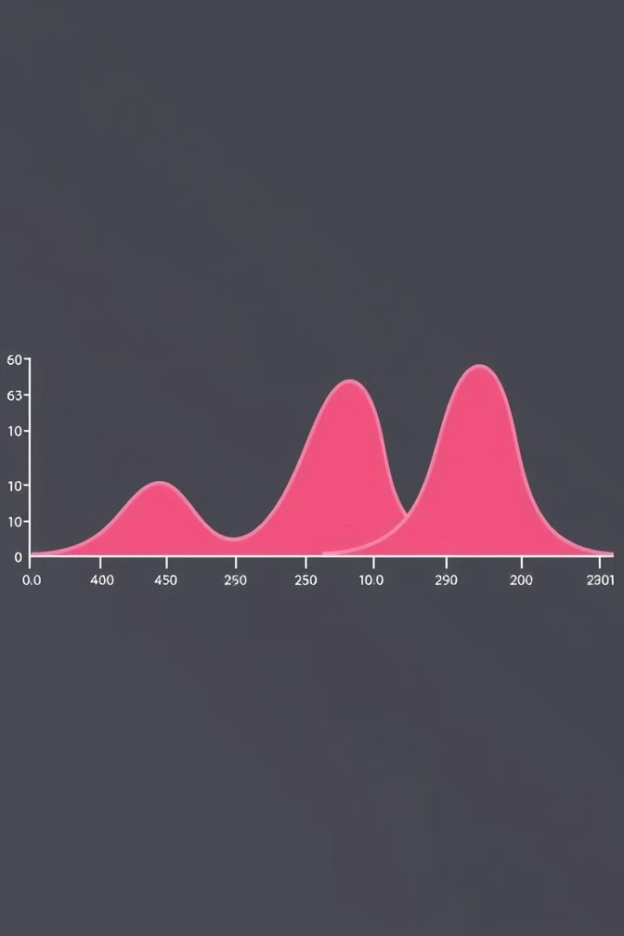
Understanding Data Distribution and Skewness
Name- Shweta

Slide 2
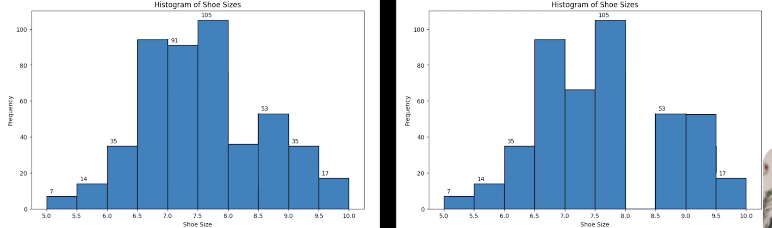
What is a Distribution?
Data Spread
Visualizations
Shoe Size Example
A distribution shows how data points spread across values.
Histograms, PDFs, PMFs and tables visualize data distributions.
Distributions help us see shoe sales range and concentrations.

Slide 3
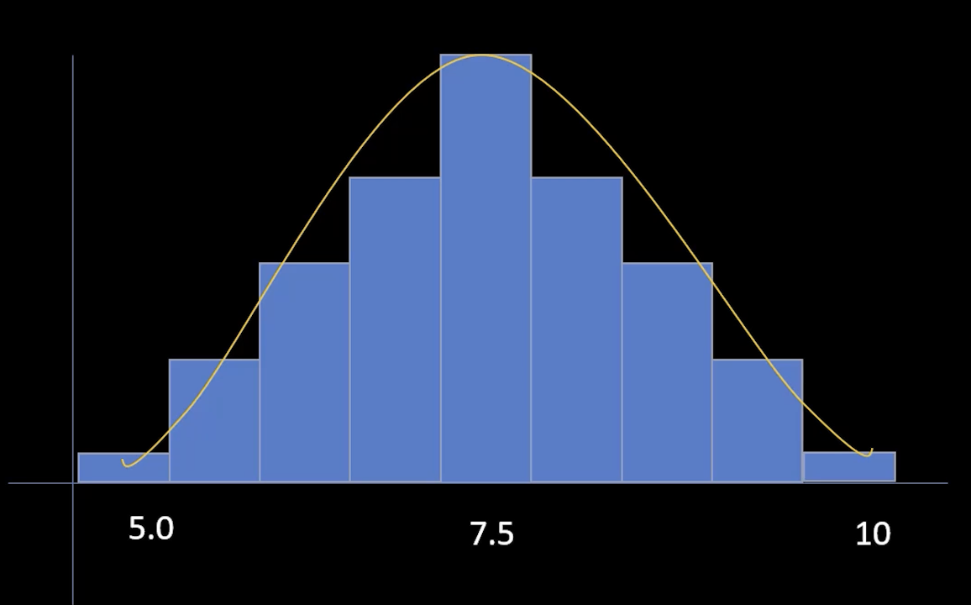
What is a Distribution?
Data Spread
Visualizations
Shoe Size Example
A distribution shows how data points spread across values.
Histograms, PDFs, PMFs and tables visualize data distributions.
Distributions help us see shoe sales range and concentrations.
PDFs- Probability Density Functions (Continuous Data)
PMFs- Probability Mass Functions (Discrete Data)

Slide 4
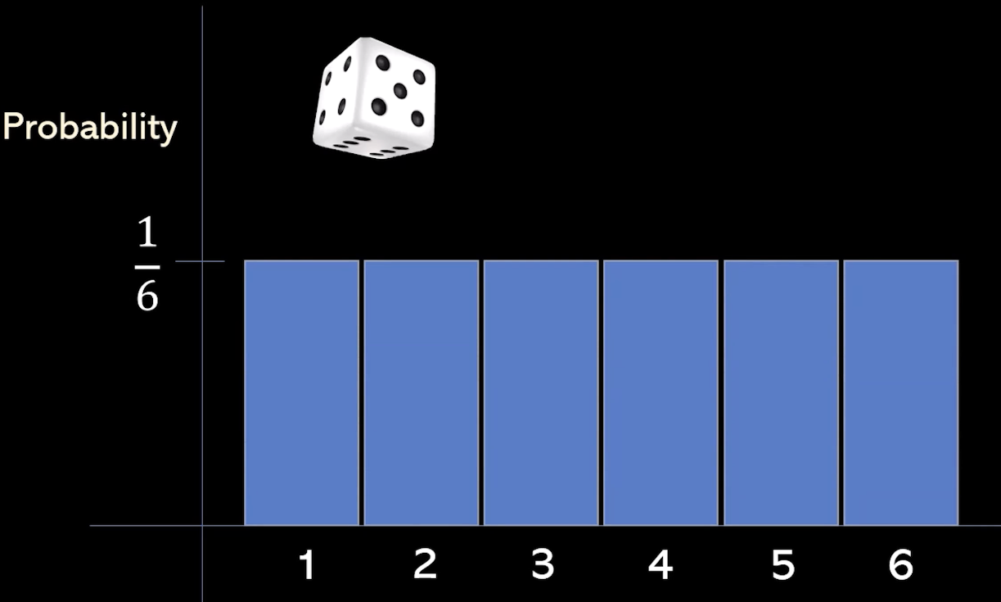
Types of Distributions
1
Uniform Distribution
All outcomes have equal probability.
Ex: Fair Dice
2
Normal Distribution
Symmetrical, bell-shaped curve.
Ex: Shoe Size

Slide 5
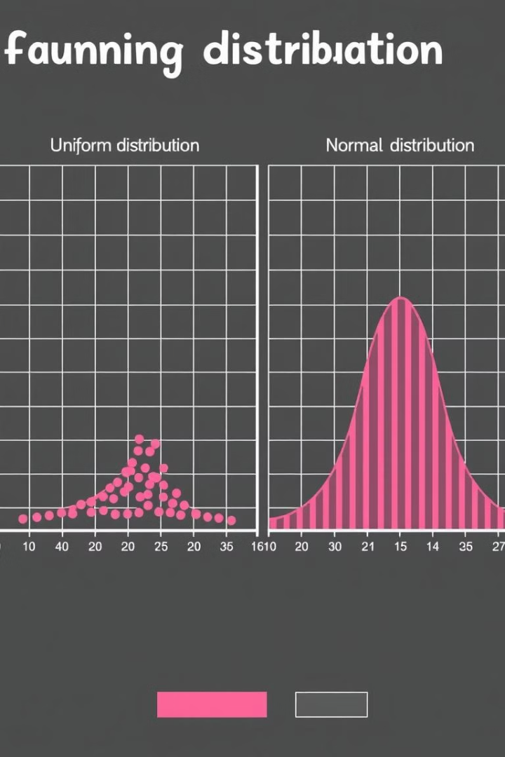
Types of Distributions
1
Uniform Distribution
All outcomes have equal probability.
Ex: Fair Dice
2
Normal Distribution
Symmetrical, bell-shaped curve.
Ex: Shoe Size
5.5 6 6.5 7 7.5 8 8.5 9
Shoe Size

Slide 6



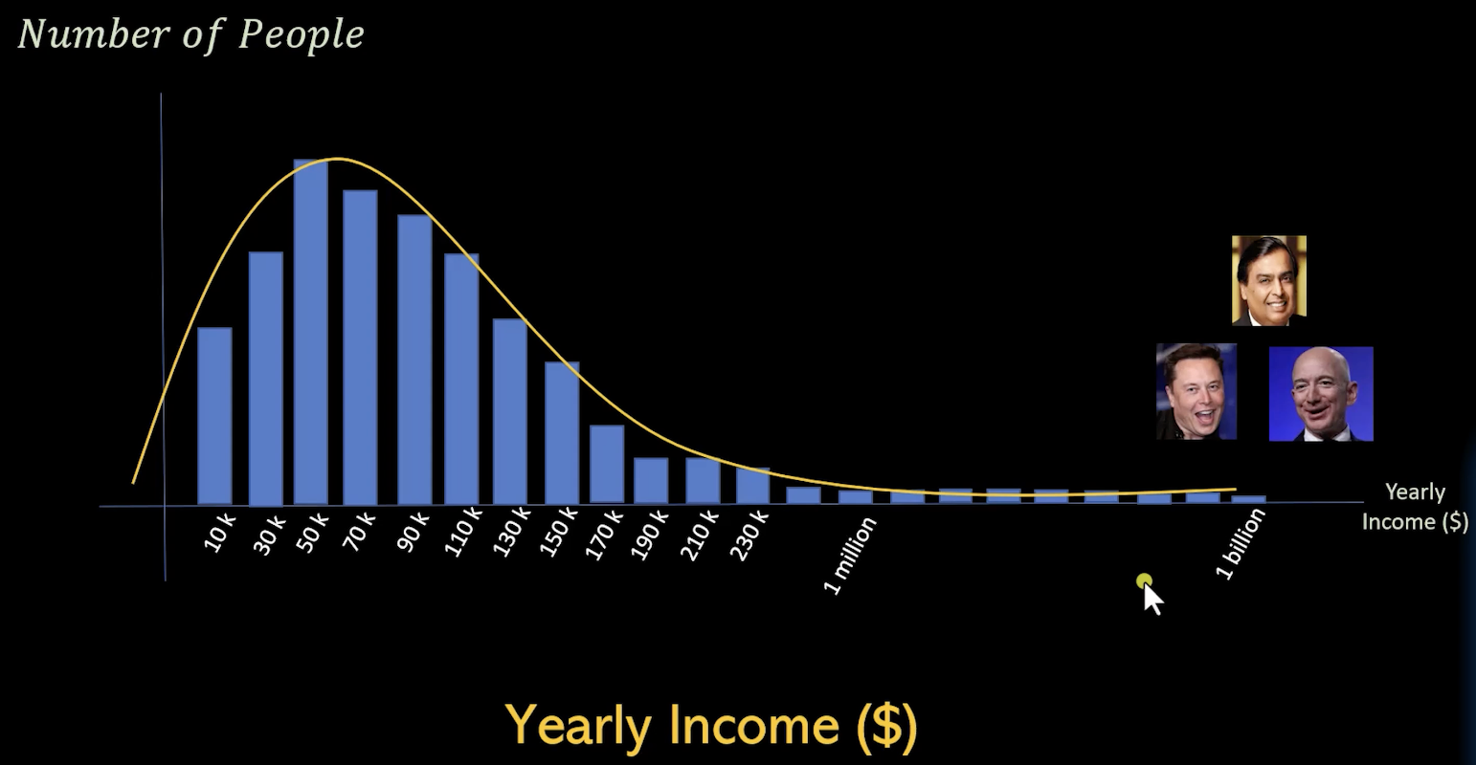
Understanding Skewness
Right/ Positive Skew
Left/ Negative Skew
No Skewness
Tail is longer on the right.
Tail is longer on the left.
Distribution is symmetrical.

Slide 7
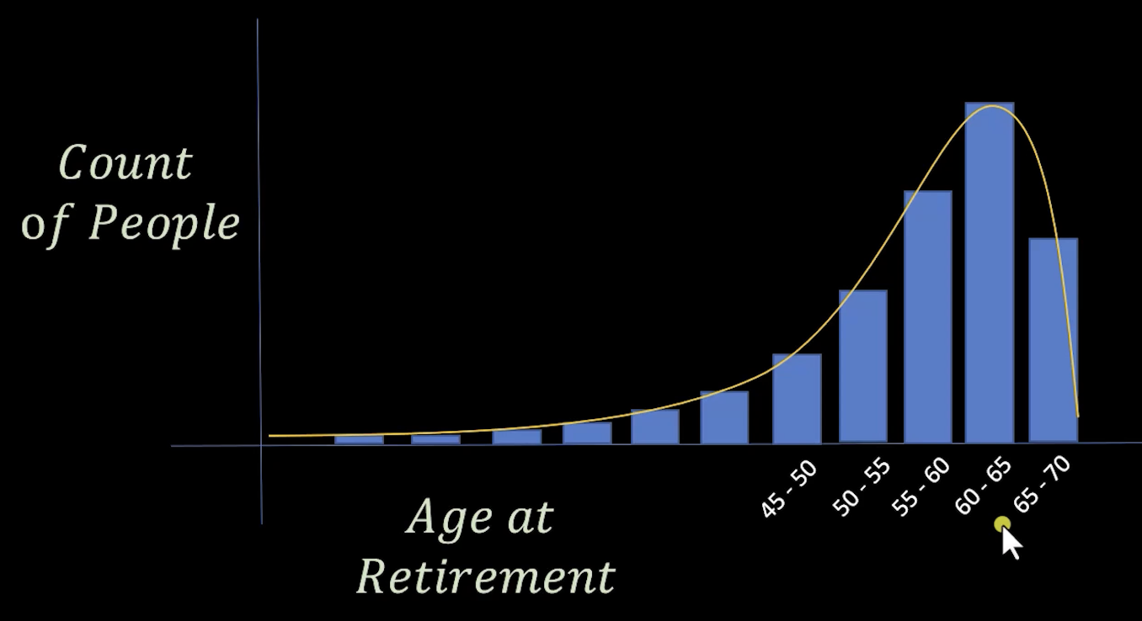
Understanding Skewness
Right/ Positive Skew
Left/ Negative Skew
No Skewness
Tail is longer on the right.
Tail is longer on the left.
Distribution is symmetrical.

Slide 8
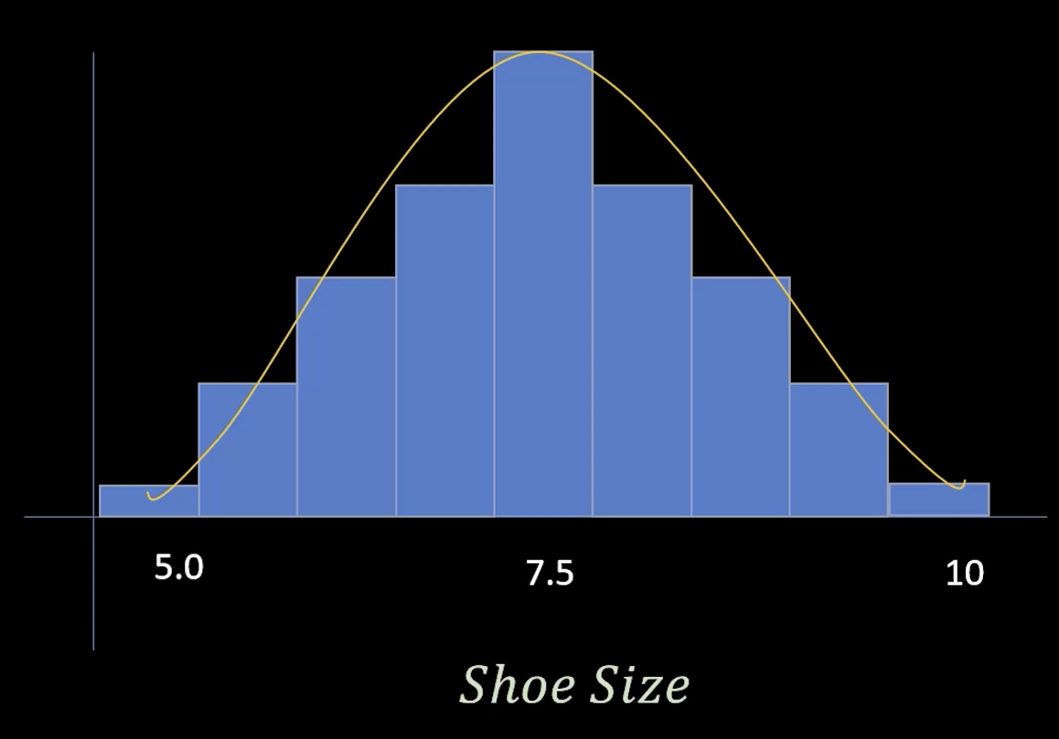
Understanding Skewness
Right/ Positive Skew
Left/ Negative Skew
No Skewness
Tail is longer on the right.
Tail is longer on the left.
Distribution is symmetrical.

Slide 9




Real-World Examples of Skewness
Right-Skewed
Salaries, housing prices.
Left-Skewed
Retirement age.
Symmetric
IQ scores, height.

Slide 10
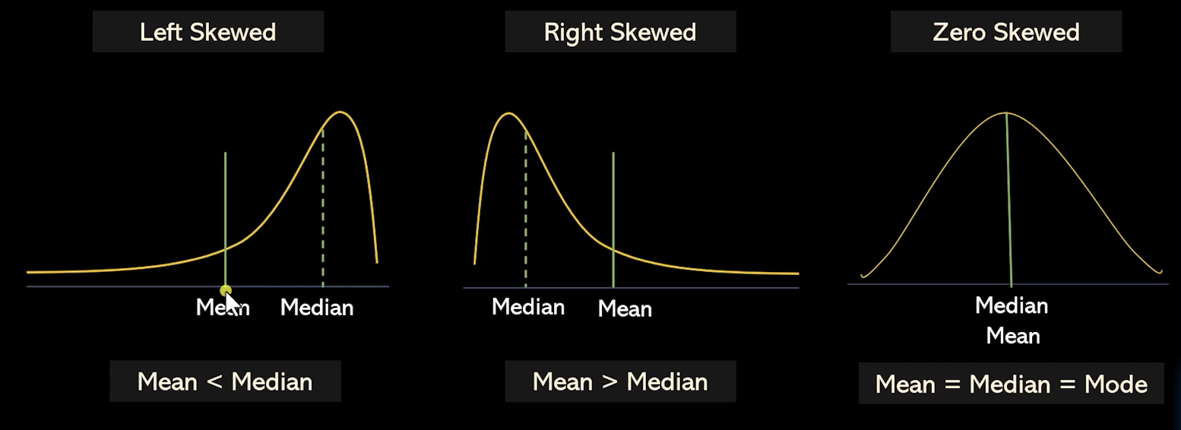
Why is Skewness Important?
Decision-Making
Statistical Measures
Medical Studies
Financial Risk
Skewness affects mean and standard deviation.
Understand skewness for financial risk analysis.
Skewness matters for medical studies and forecasting.

Slide 11




Why is Skewness Important?
Decision-Making
1
Statistical Measures
2
4
Medical Studies
3
Financial Risk
Skewness affects mean and standard deviation.
Understand skewness for financial risk analysis.
Skewness matters for medical studies and forecasting.

